Slide 1
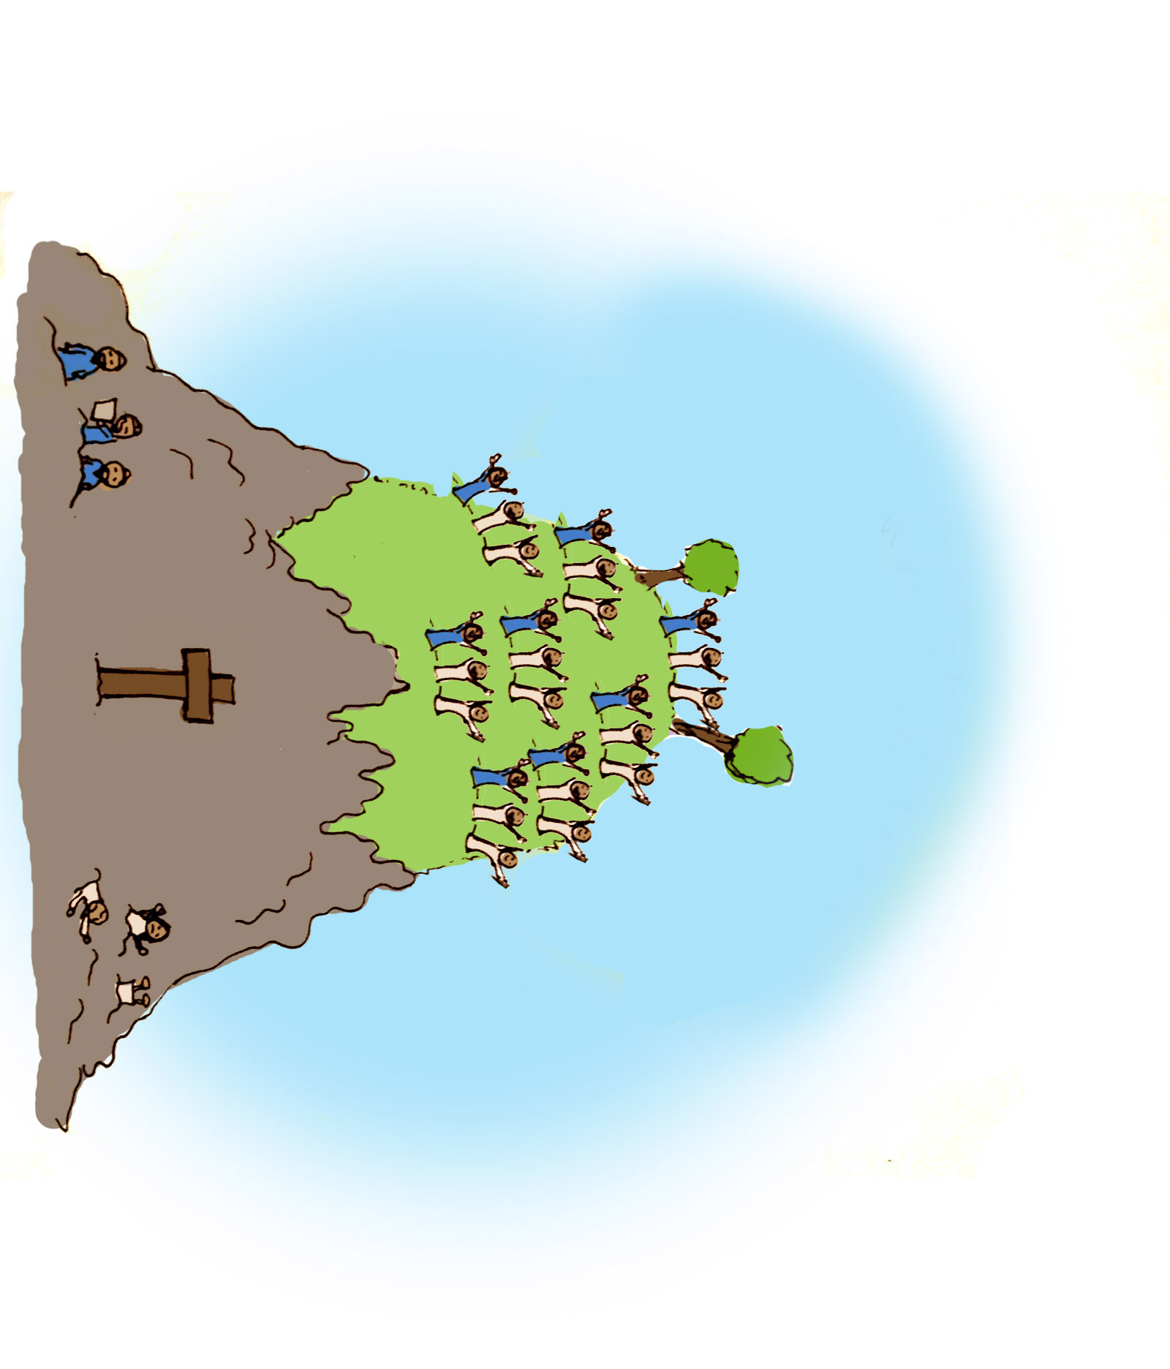
How GREAT
a Salvation

Slide 2
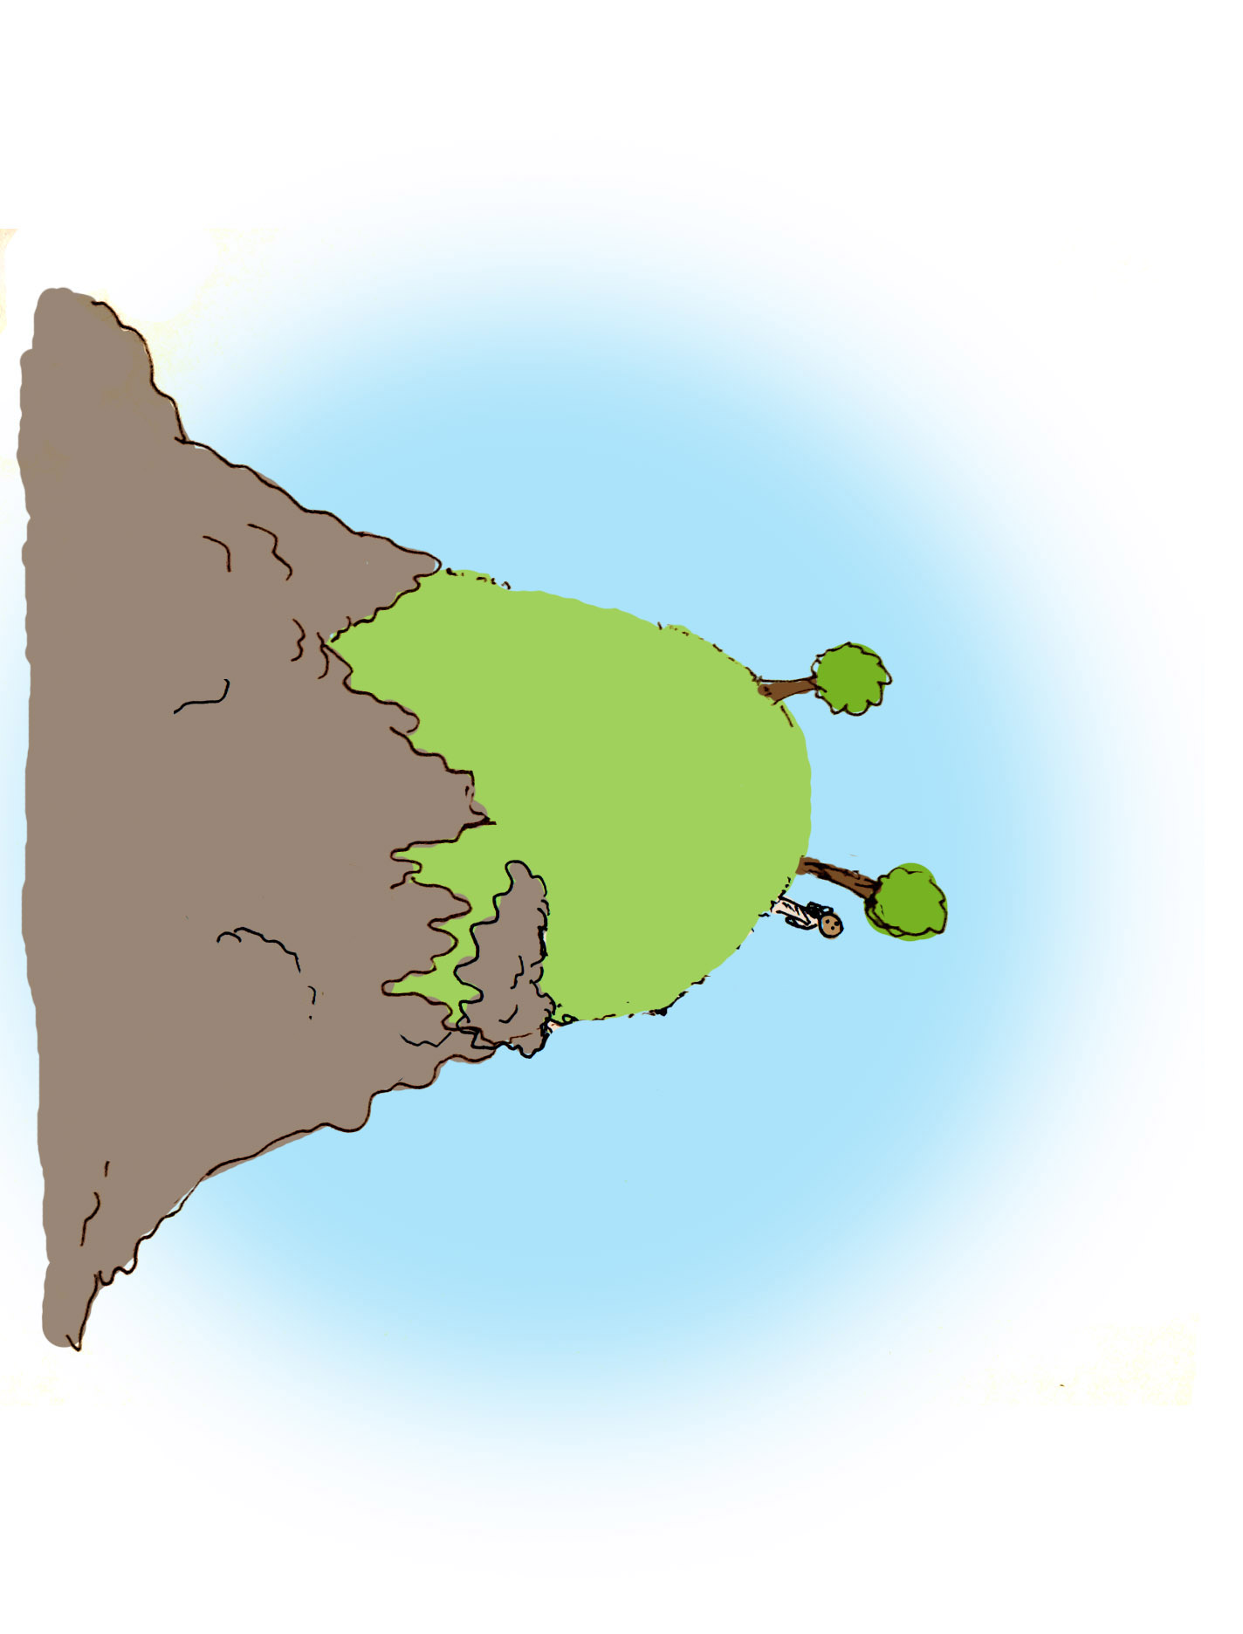

Slide 4
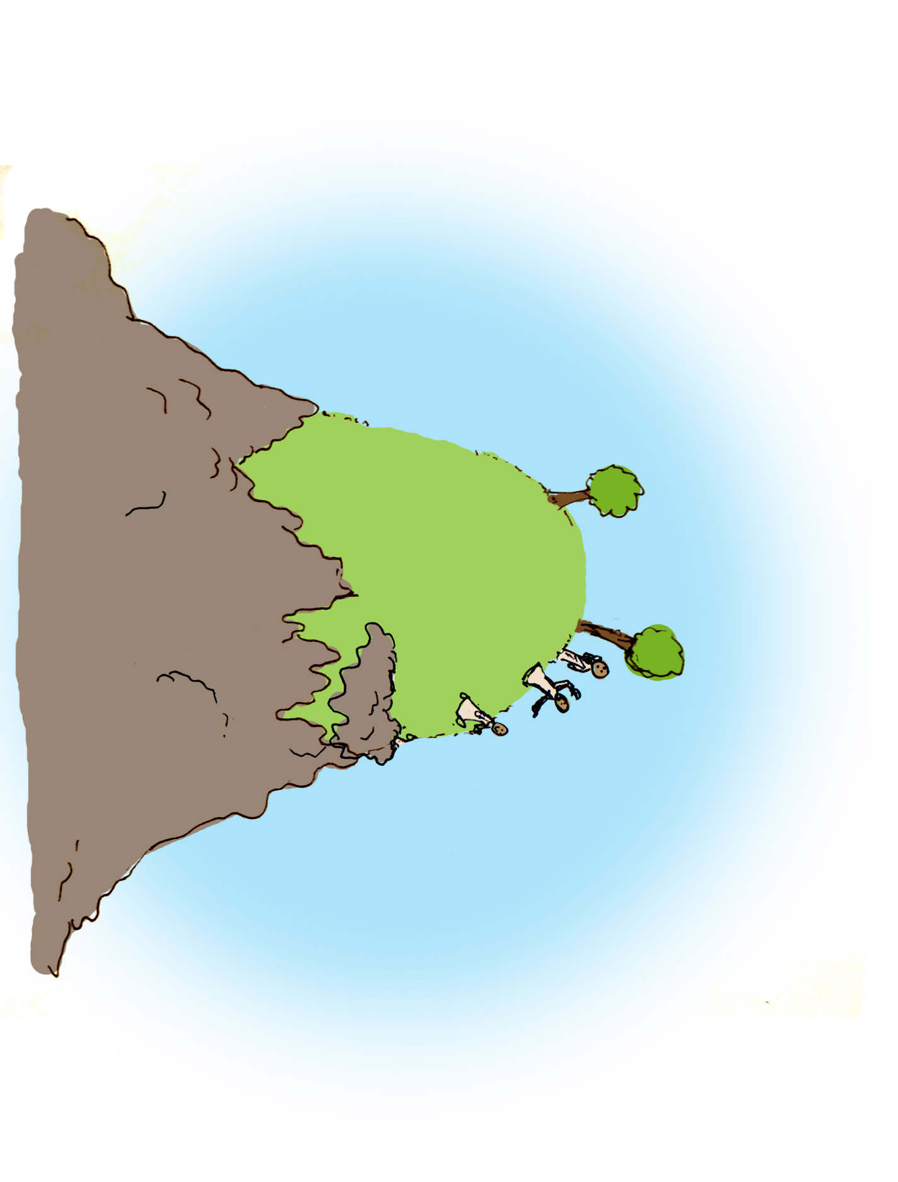

Slide 5
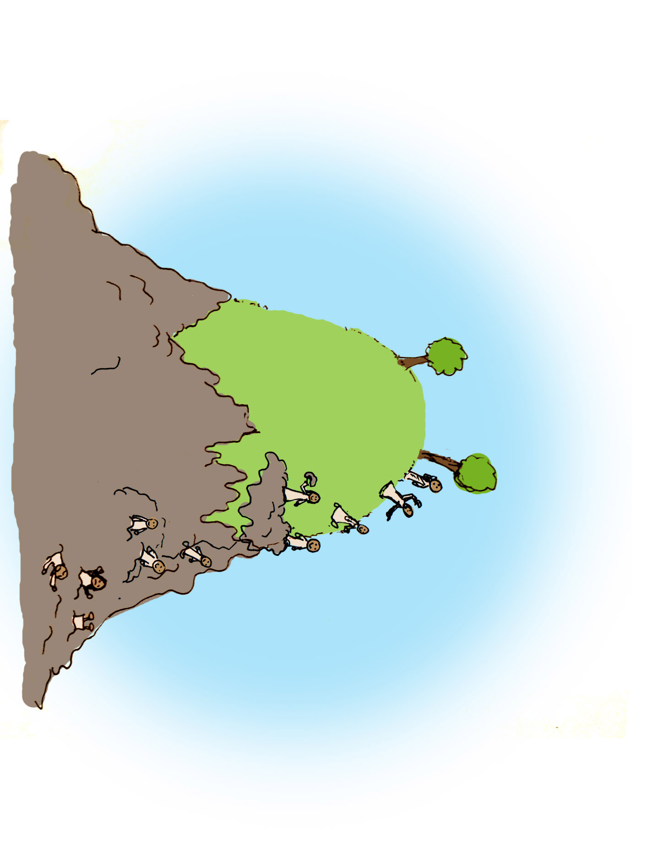

Slide 6
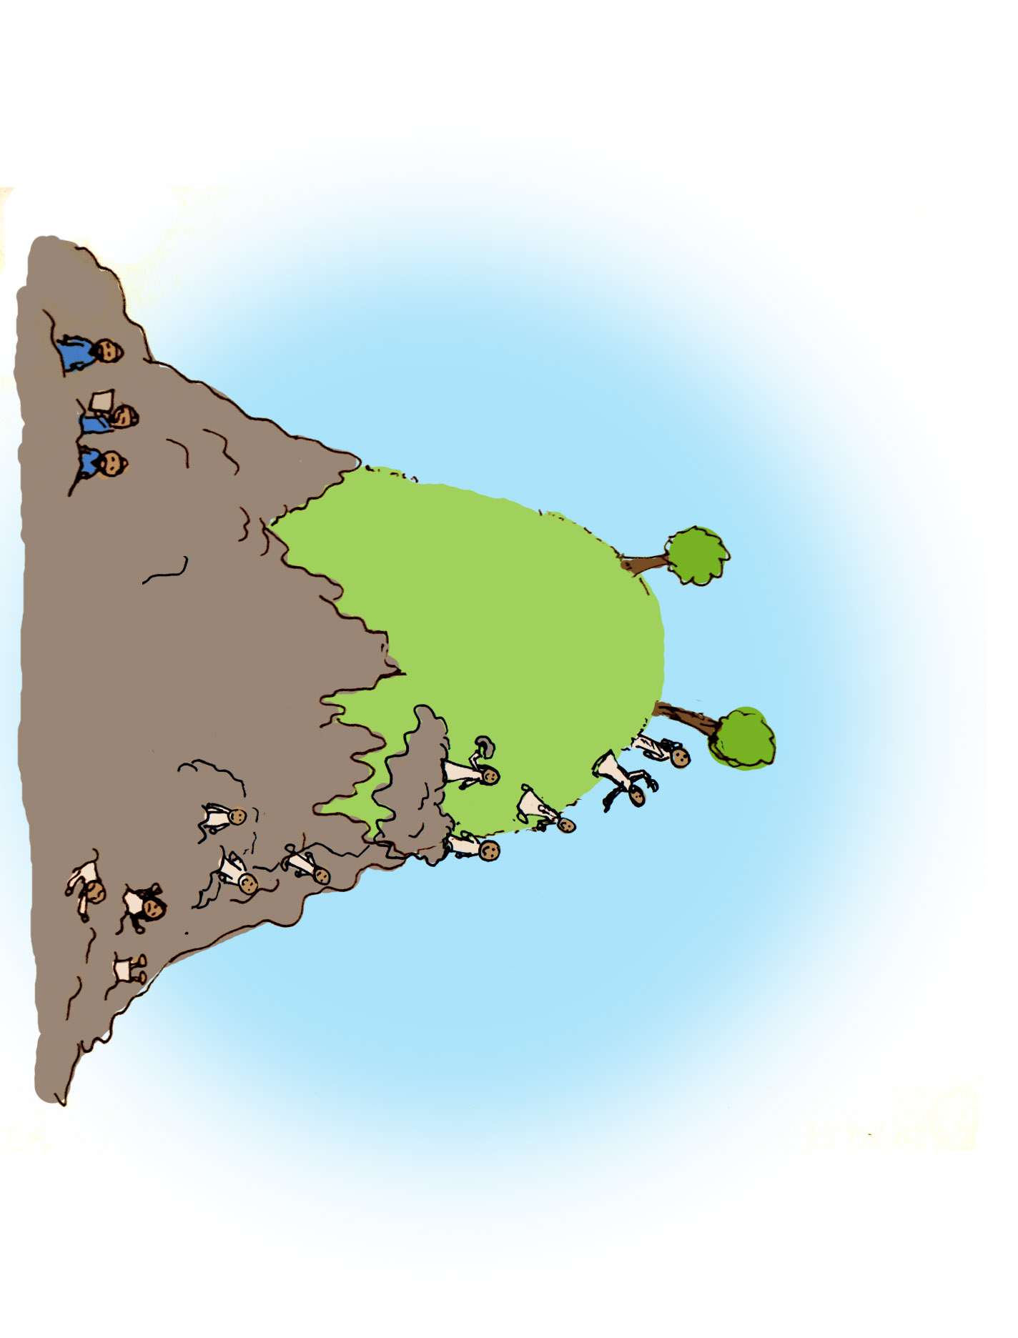

Slide 7
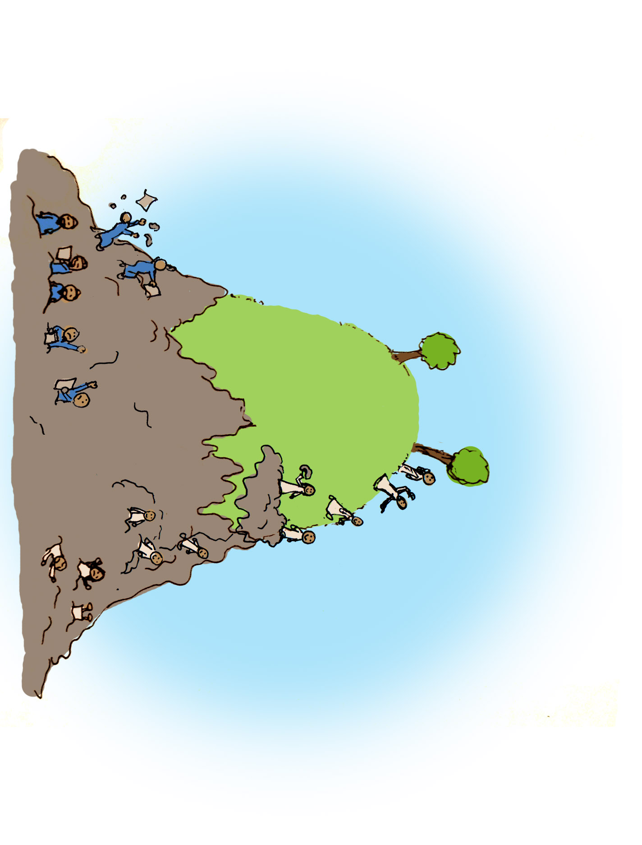

Slide 8
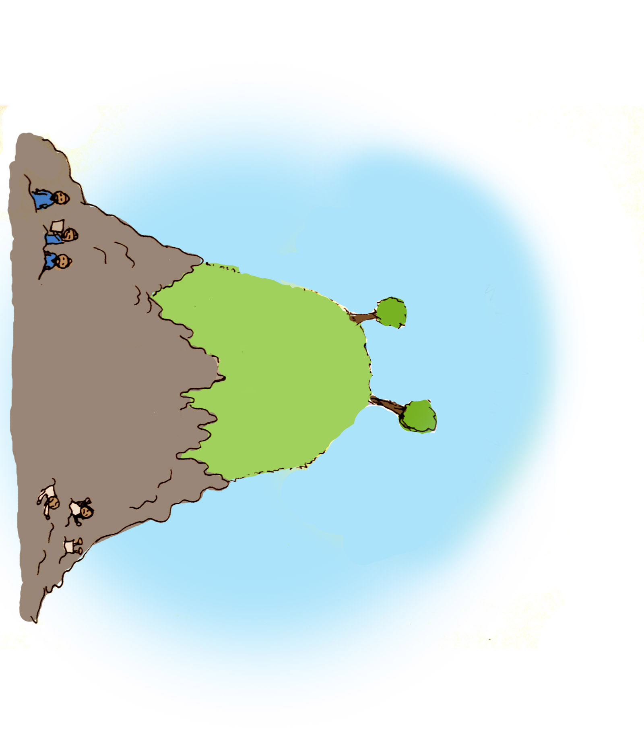
The Message of the Gospel
Romans 3:21-26

Slide 9
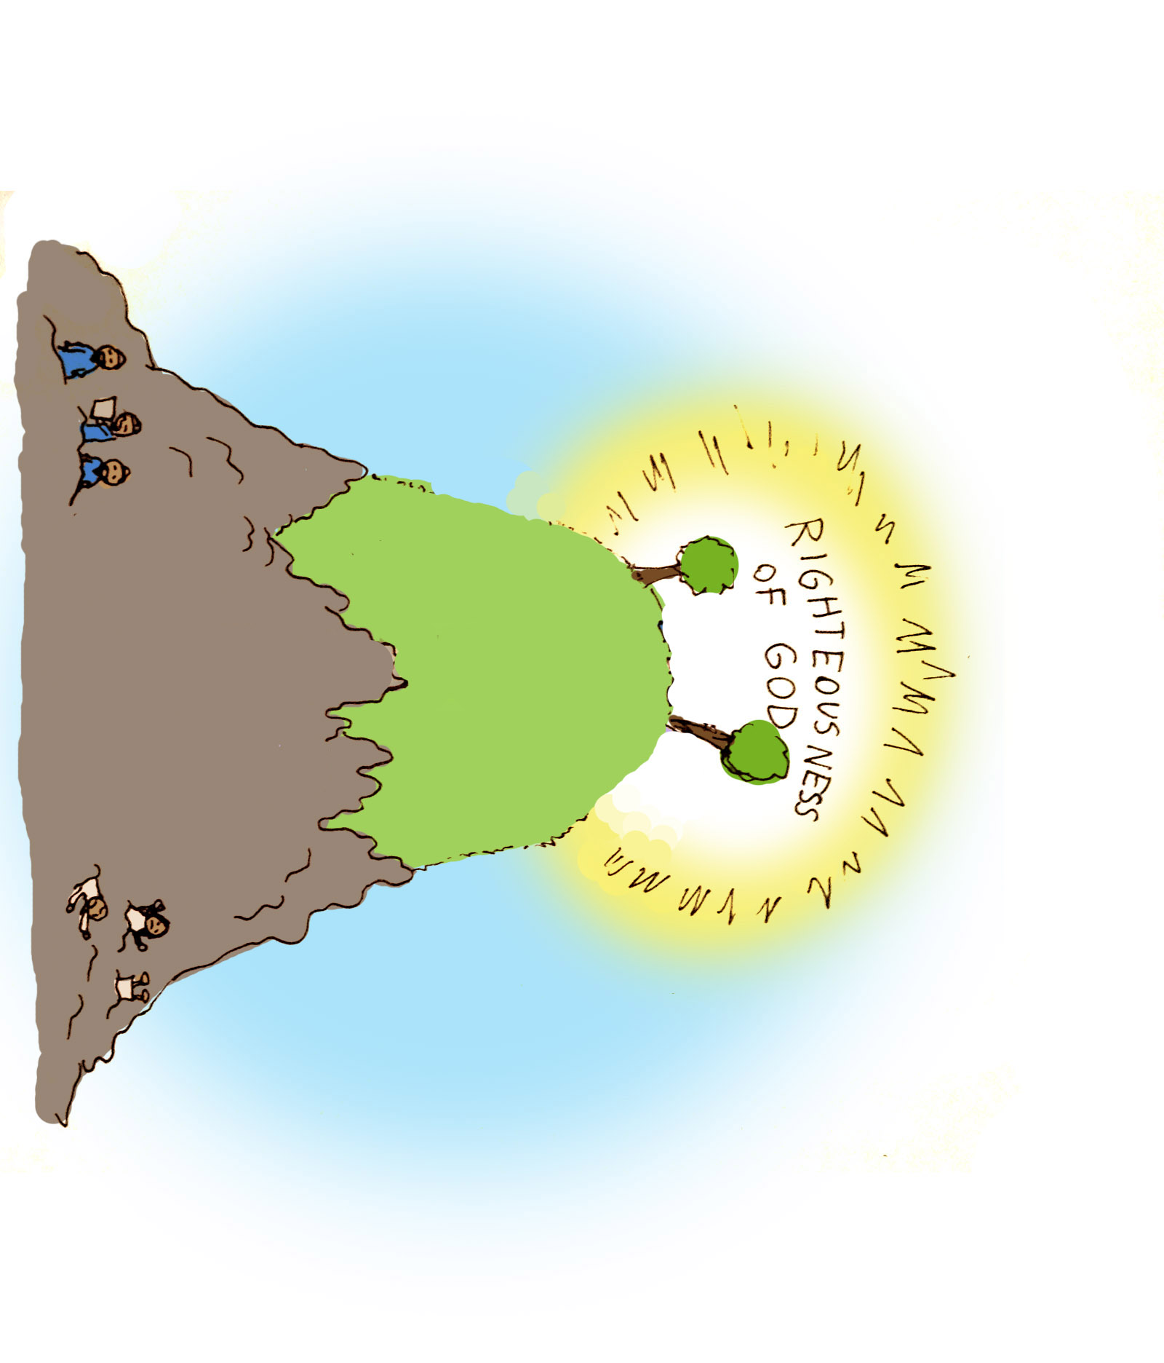
The Message of the Gospel
Romans 3:21-26

Slide 10
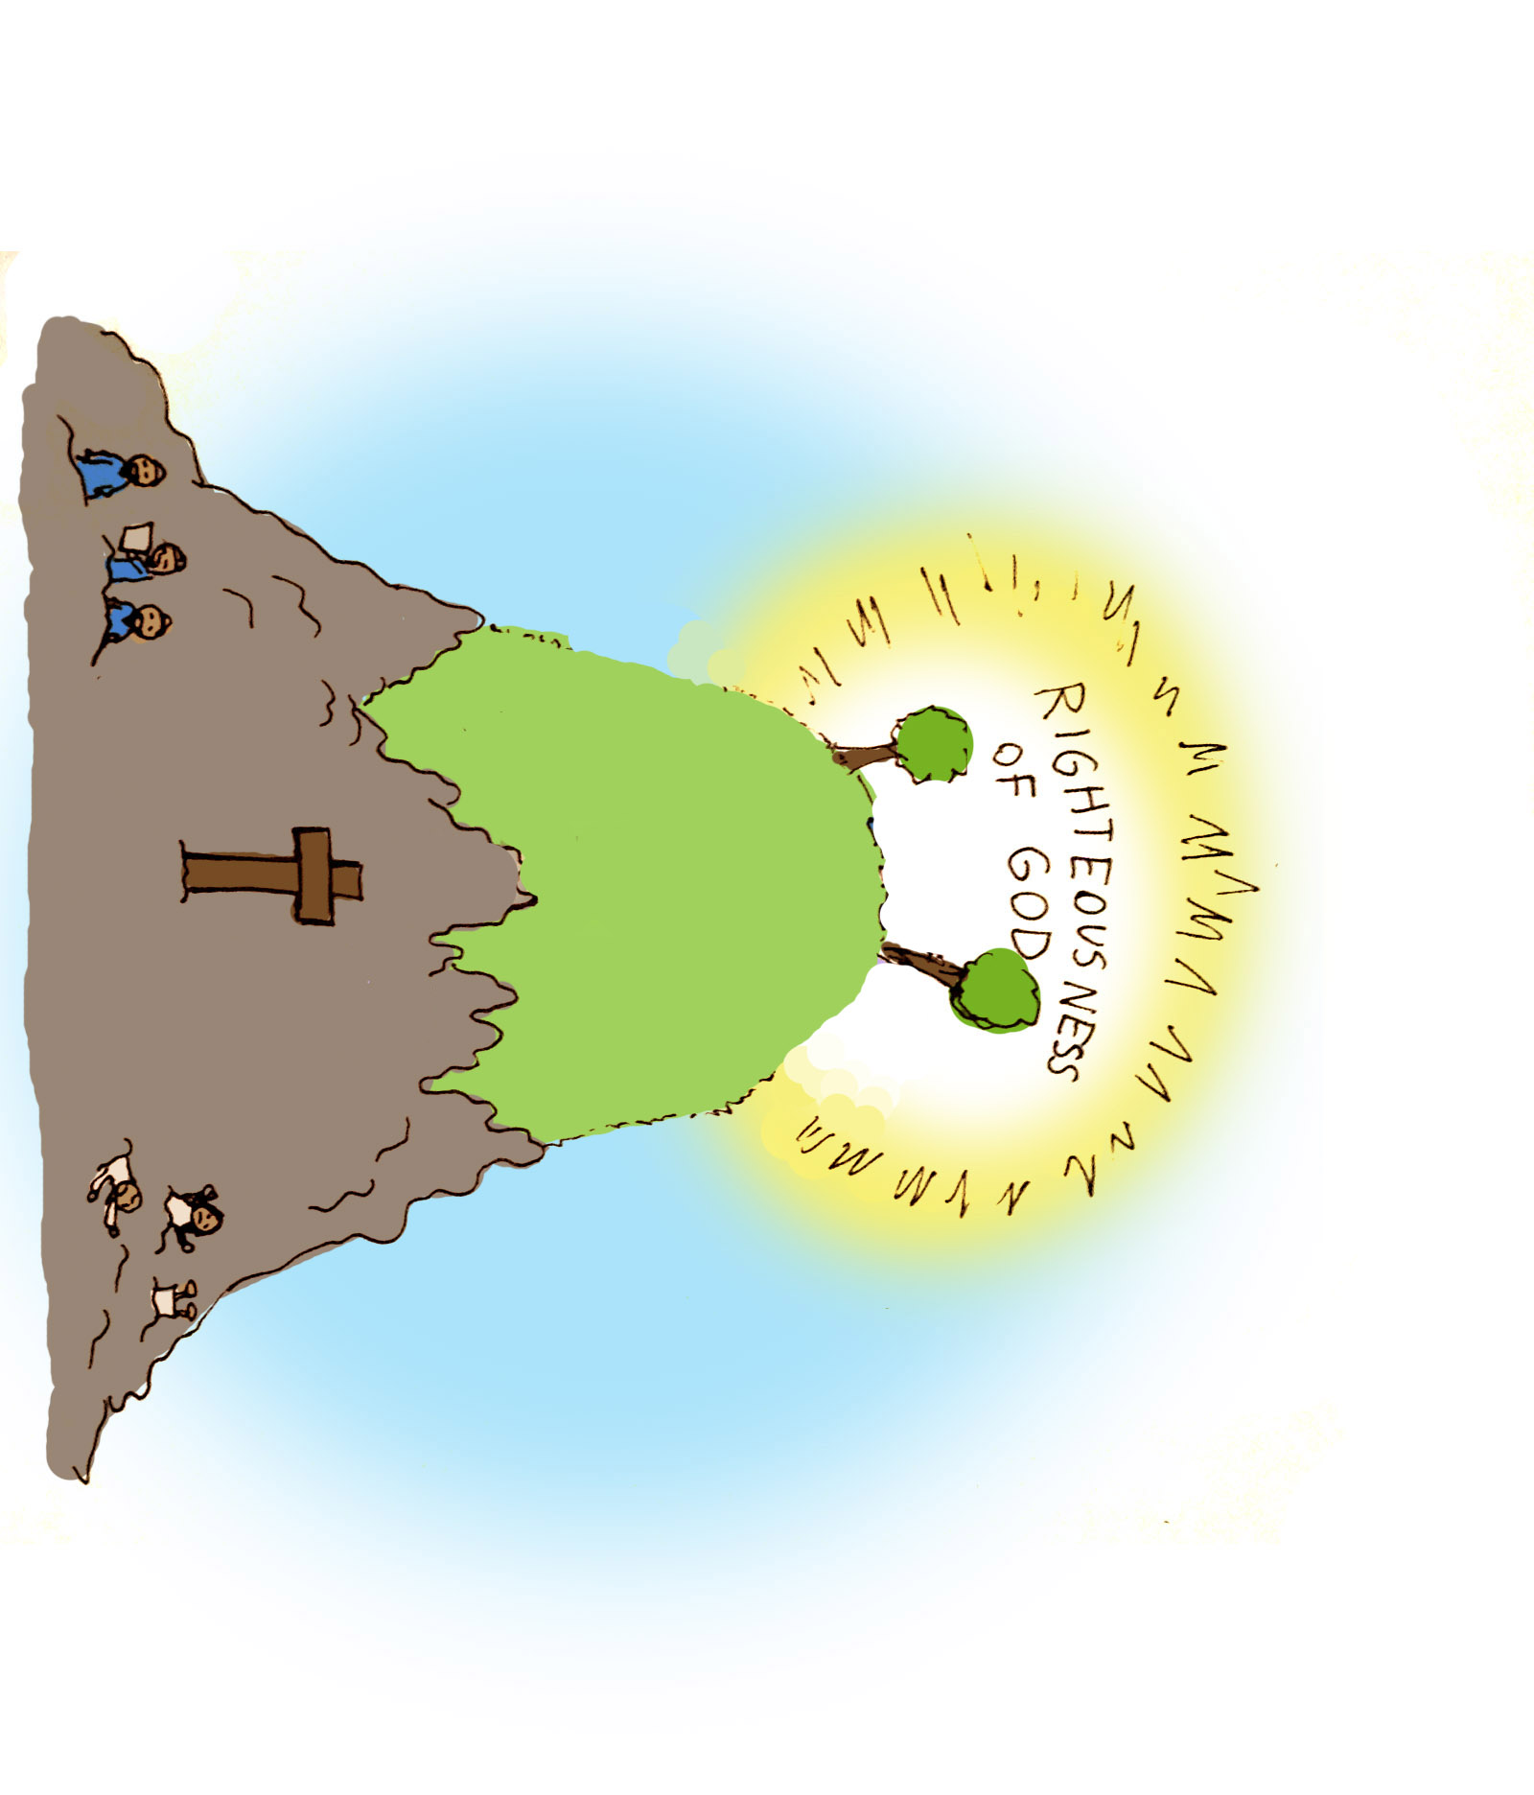
The Message of the Gospel
Romans 3:21-26

Slide 11
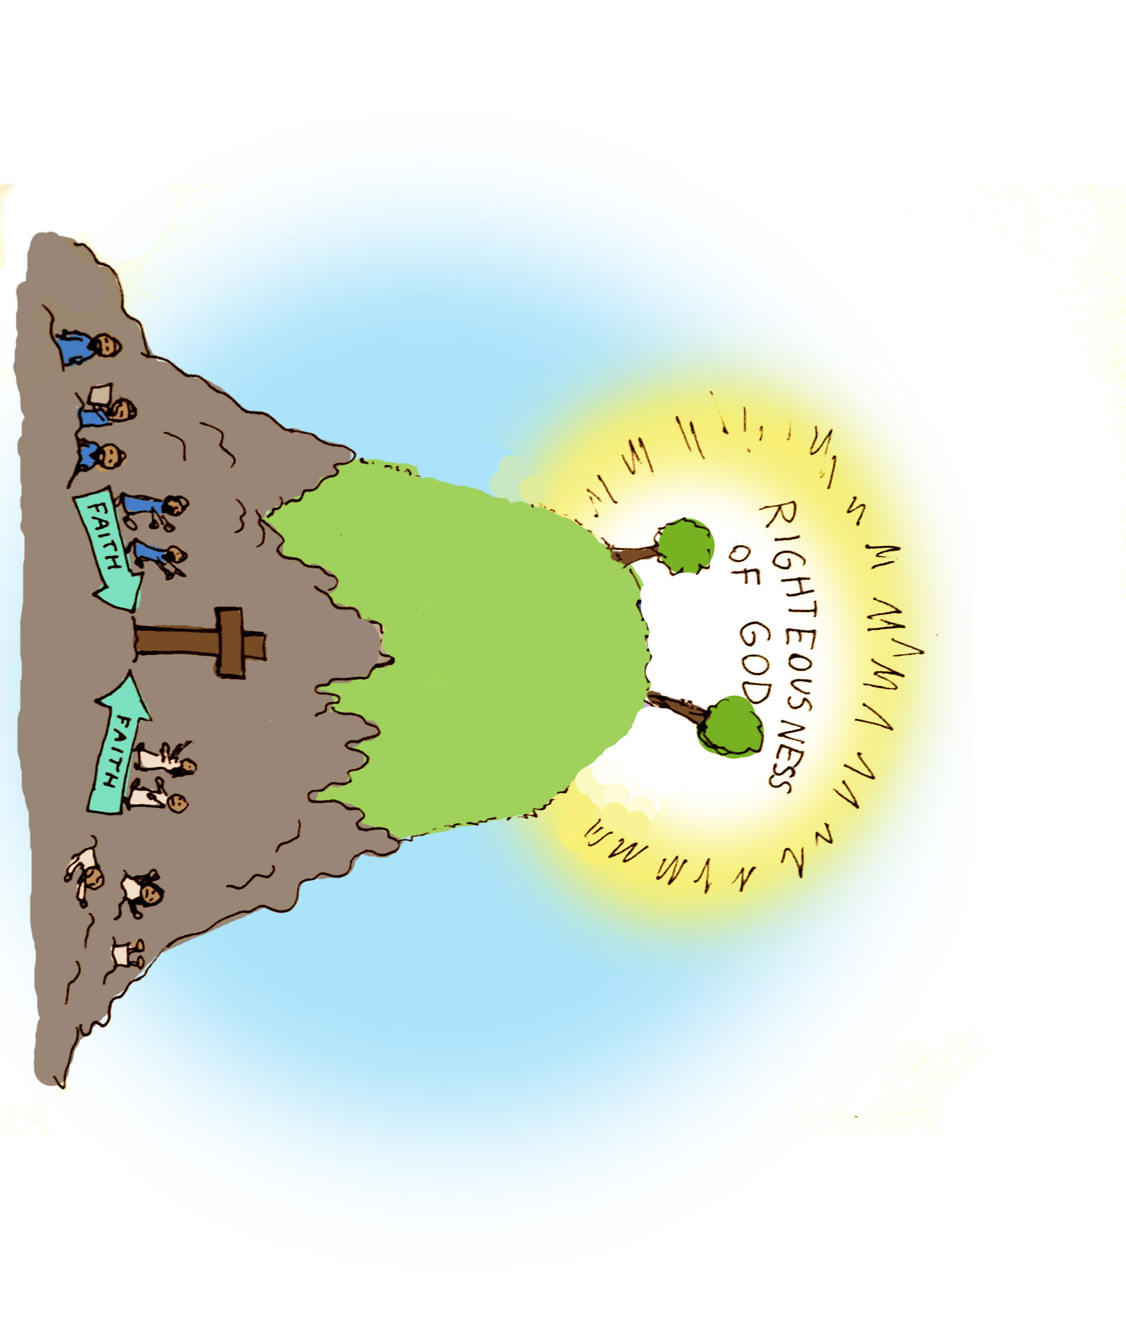
The Message of the Gospel
Romans 3:21-26

Slide 13
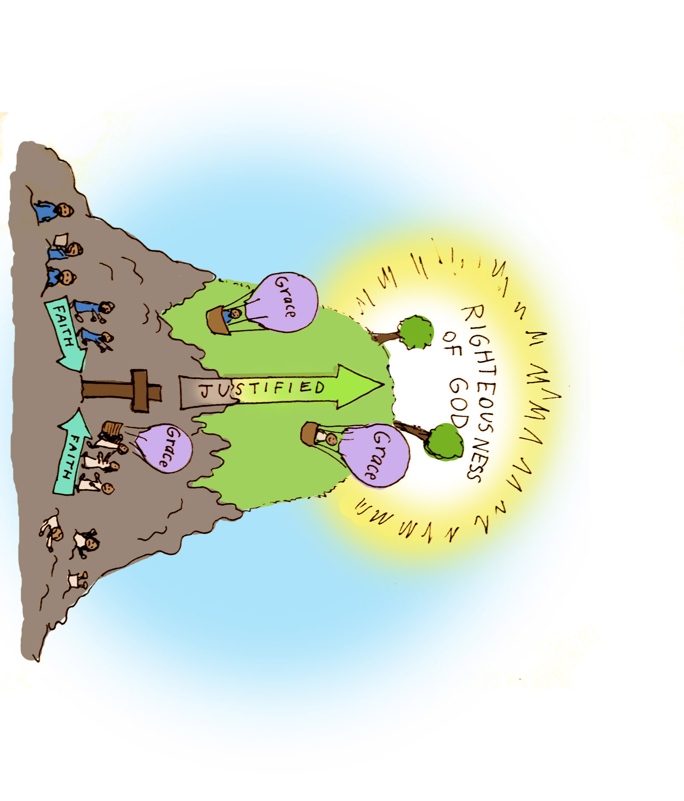

Slide 14
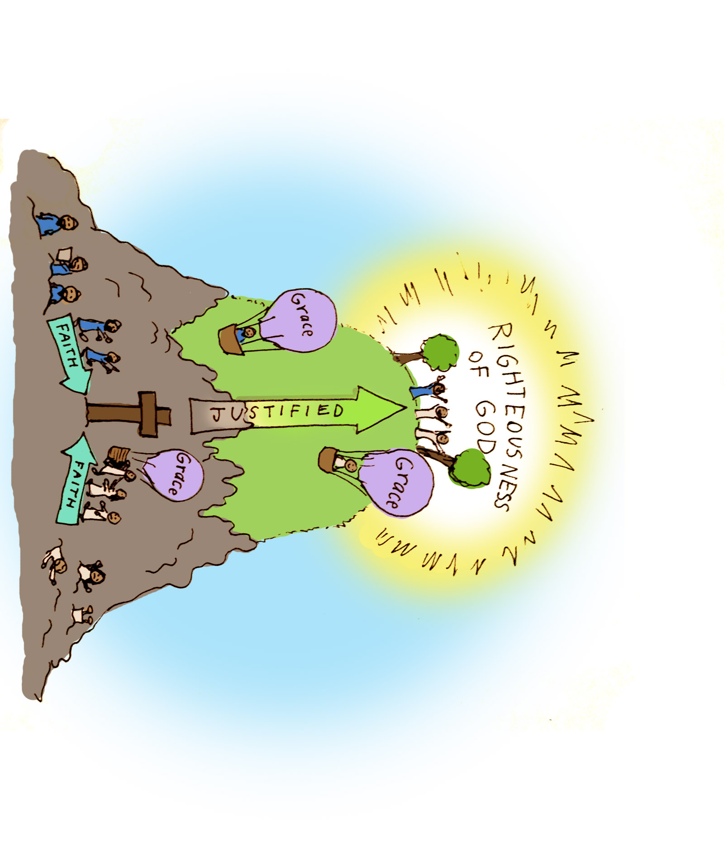

Slide 15
Illustration of
“The Righteousness of God”
Romans 4:1-7
Illustration of
“Justified By Grace”
Romans 4:6-8
Illustration of
“All Who Believe”
Romans 4:9-12
Illustration of
“To Be Received By Faith”
Romans 4:13-25

Slide 16
Peace With God
Romans 5

Slide 21
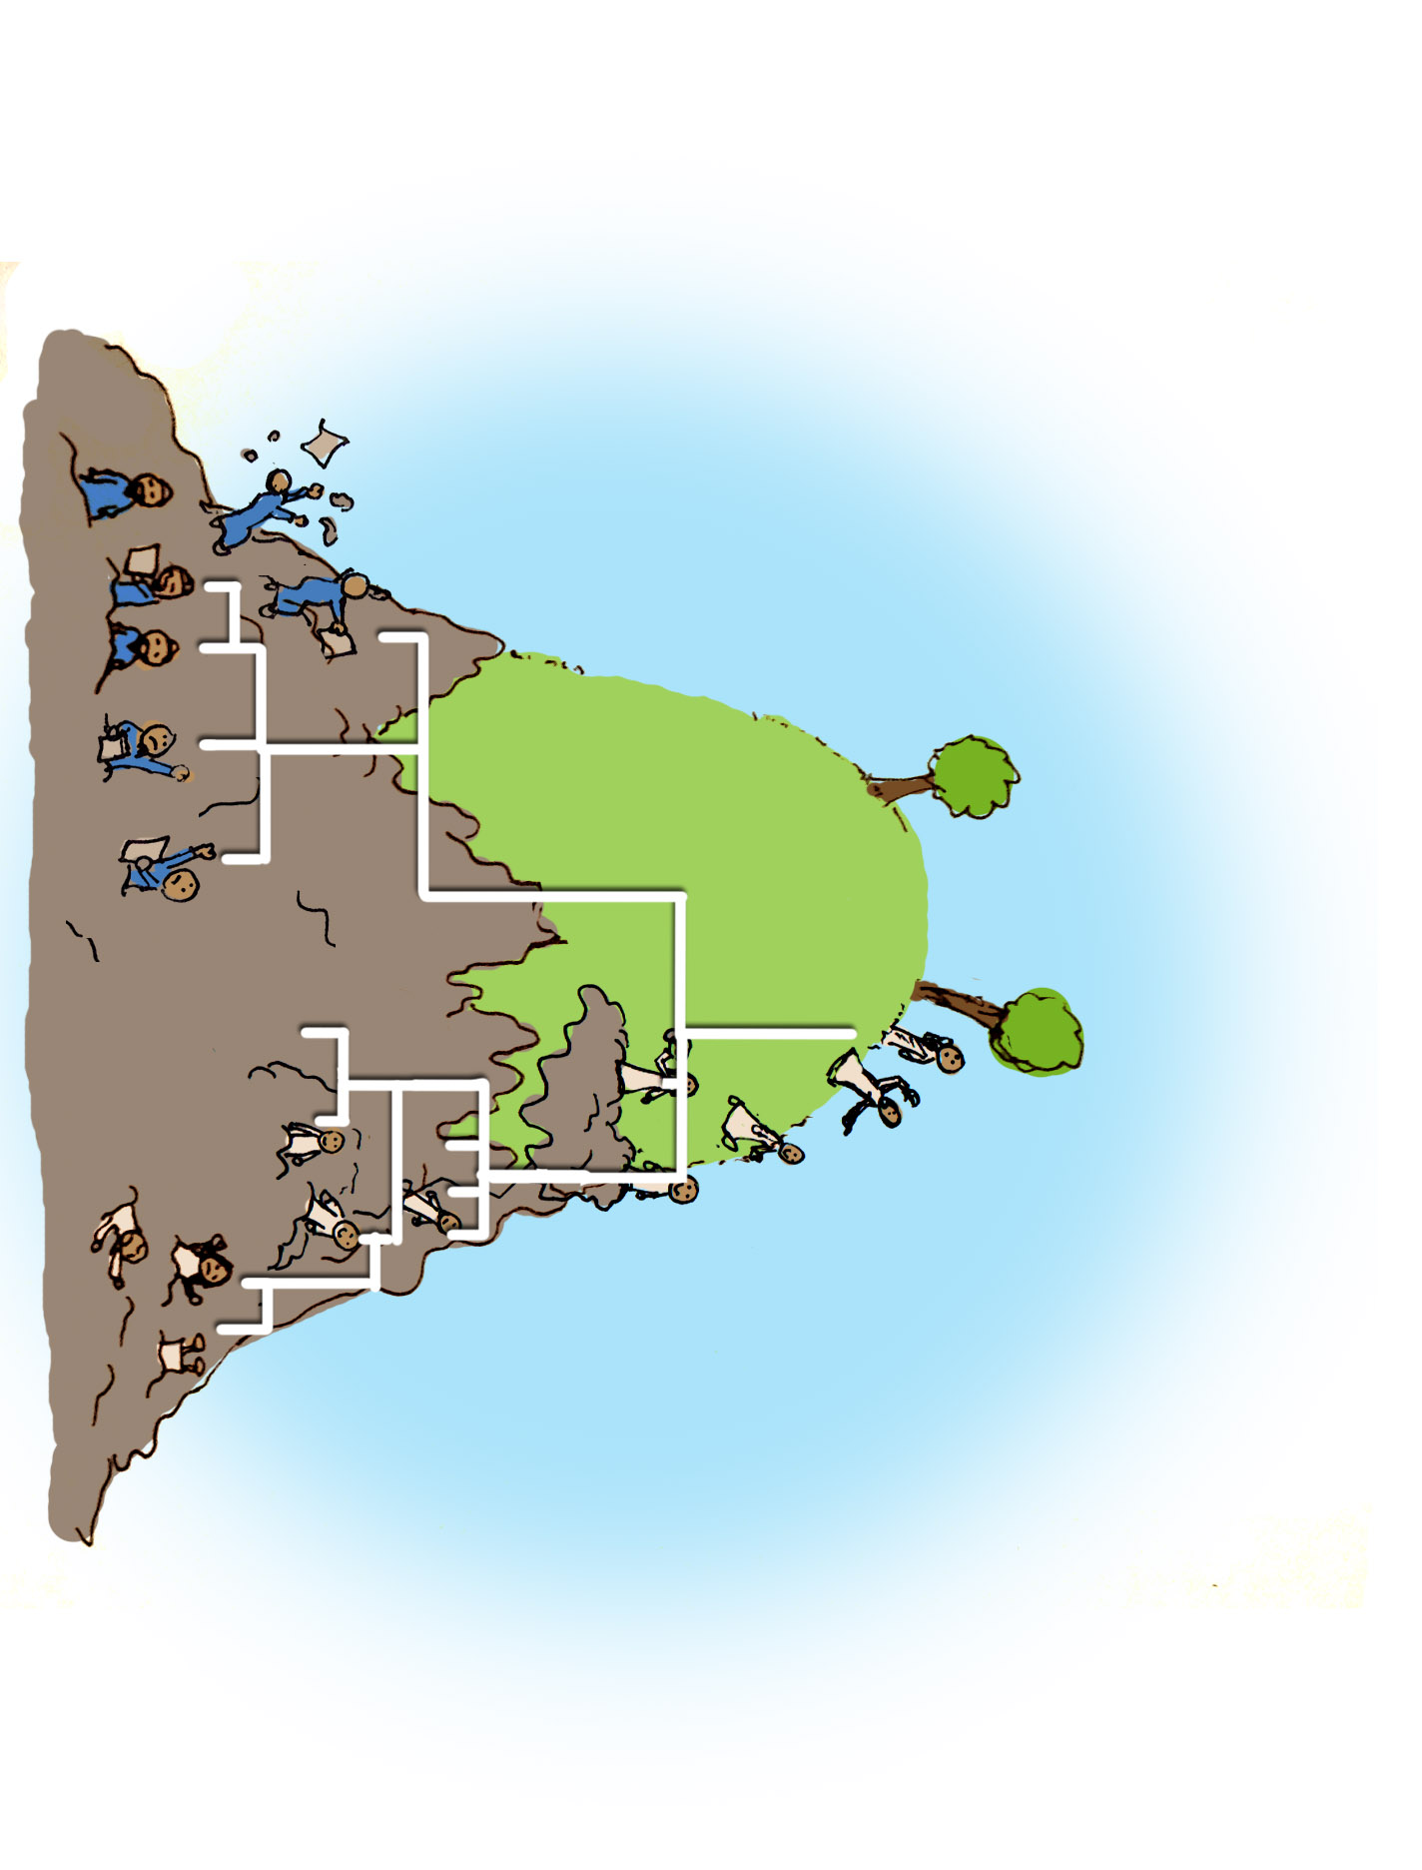

Slide 23
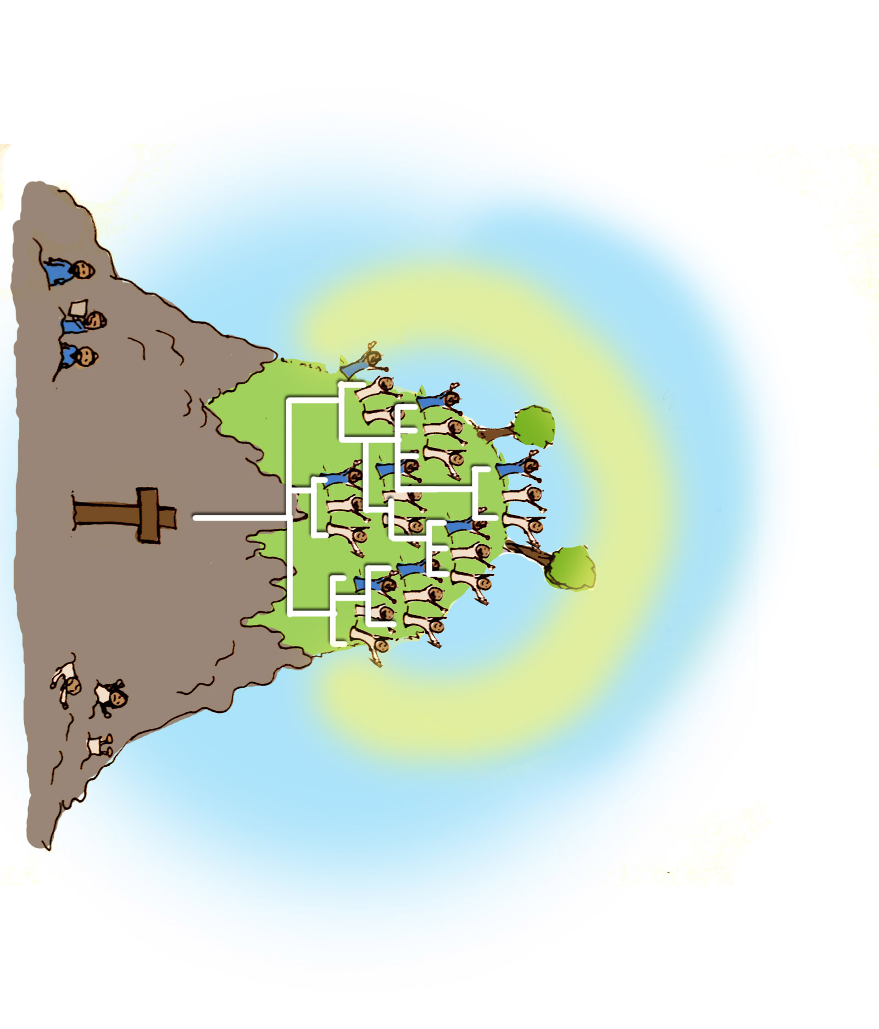

Slide 24
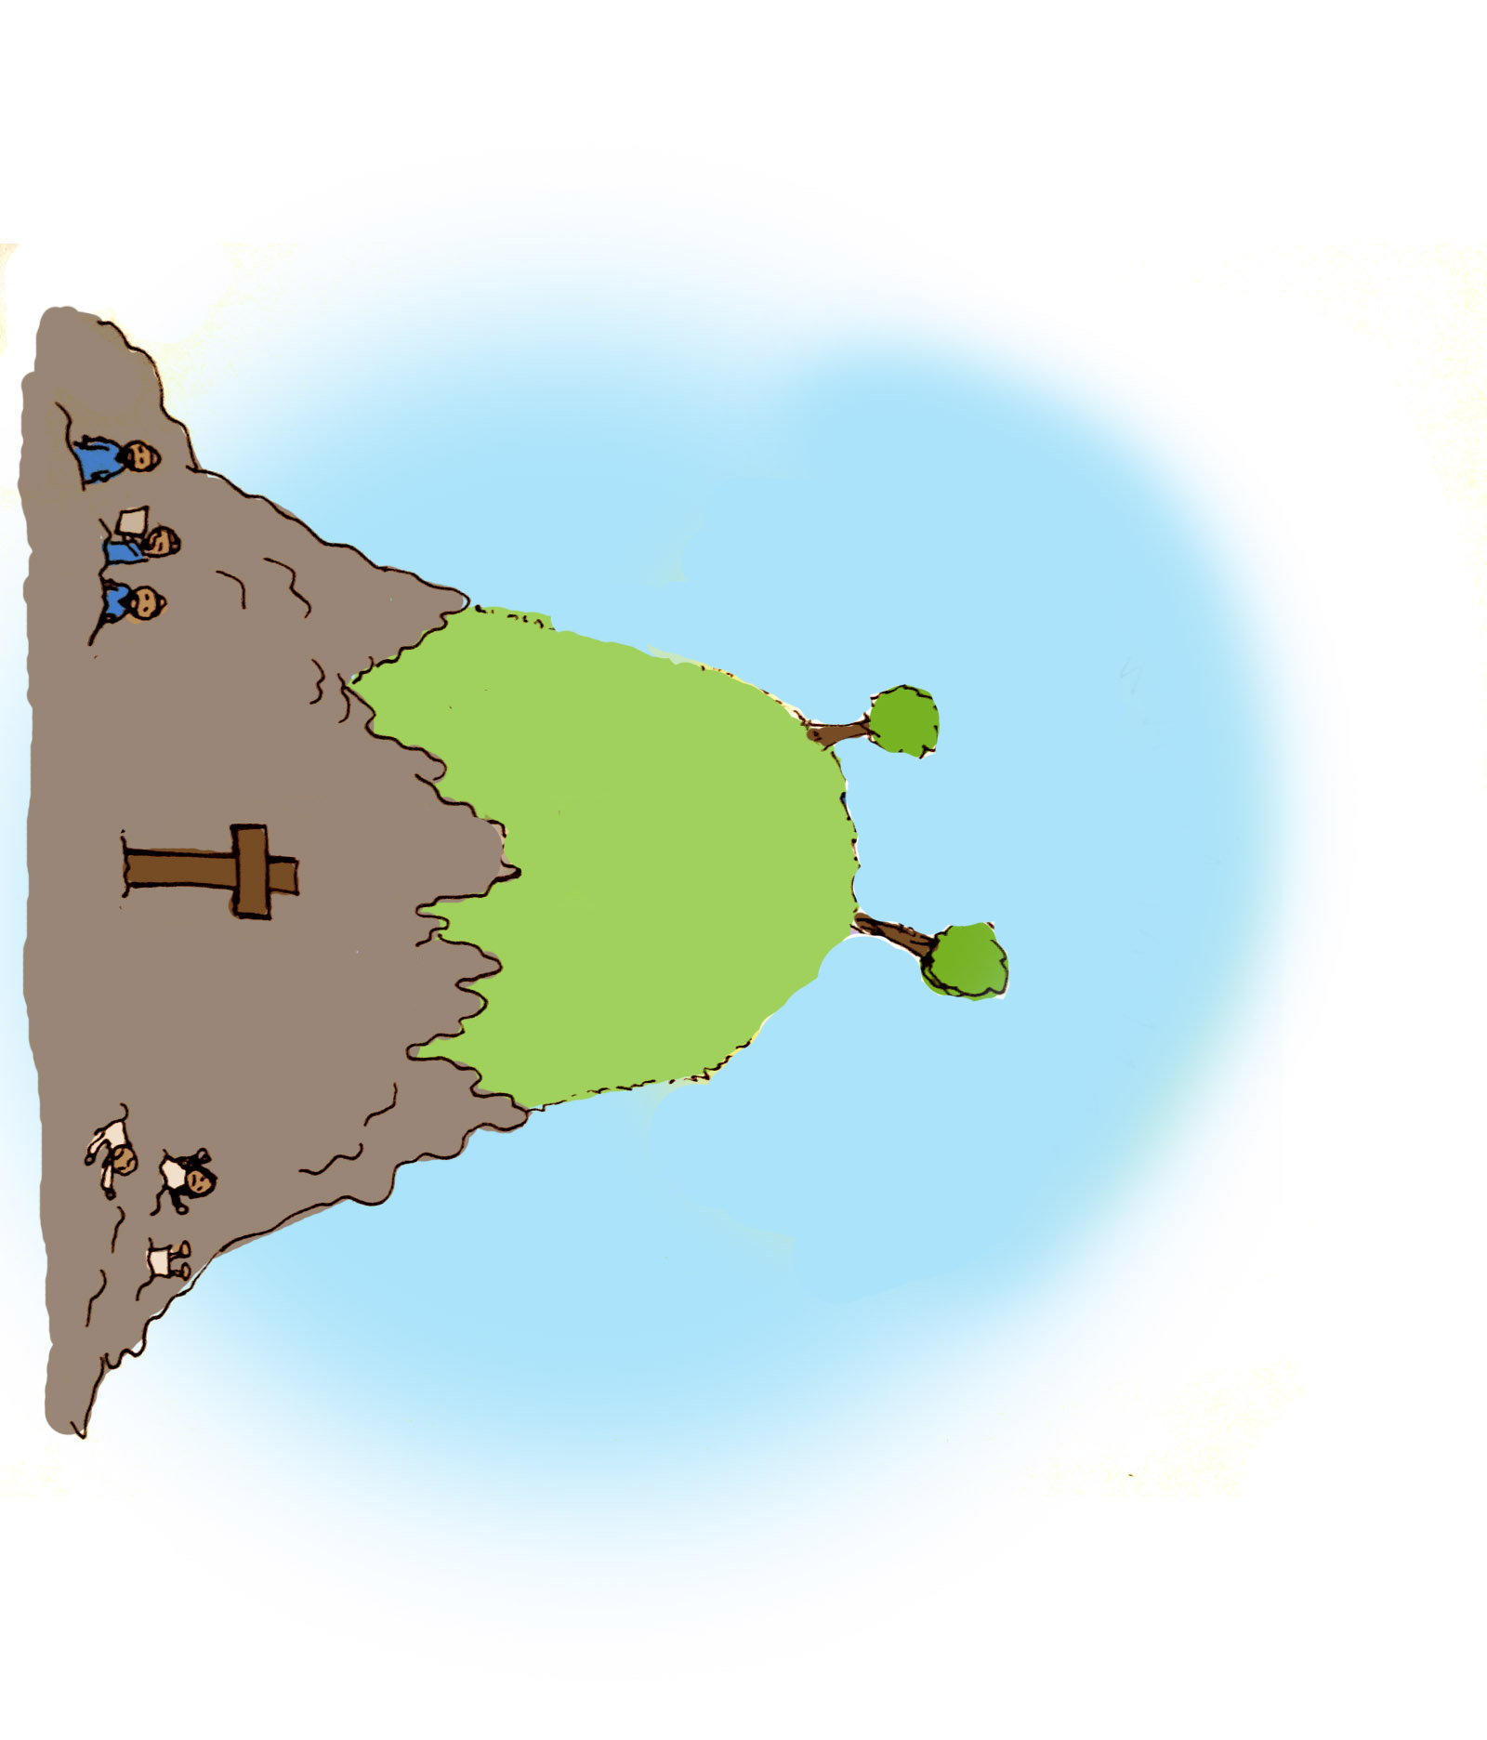

Slide 25
How GREAT
a Salvation

